Slide 1



Truvel

Slide 2

Truvel Where Should you Travel to?
An interface designed to help people decide where to book their next vacation
M/W Group 6:
Prachi Khanna
Simret Goitom
Svitlana Balyuk
Stephanie Burr

Slide 3

Data Sources
Google Places API
Open Weather Map API
Cost of Living Index – Numbeo (via Kaggle)
Top Cities lists – Budget your Trip (via Kaggle)

Slide 4

Data Collection & Transformation - CSV Data Sources
Top cities list (.csv)
Obtained from Kaggle
Original source of data is Budget Your Trip, huge repository of data for typical travel destinations
Cost of Living Index (.csv)
Obtained from Kaggle
Original source of data is Numbeo, the world’s largest database on world living conditions

Slide 5
Data Collection & Transformation - Google Places API
Pulled data from Google Places using successive API calls
Data was collected for each city in Top Cities (.csv) using keyword search terms
Top Cities Traveled (.csv)
Hotel | Night club
Amusement park | Restaurant
Bar | Shopping mall
Café | Spa
Casino | Stadium
Museum | Zoo
Google Places API
API call returned
Name of establishments
Overall user rating by establishment
Number of total reviews by establishment
Data from was summarized by city and keyword and saved as a .csv
Overall average rating for keyword
Number of establishments returned from call by keyword
Max number of reviews by keyword
Average number of reviews by keyword
Summarized Data
by Keyword & City (.csv)

Slide 6

Data Collection & Transformation – Open Weather Map API
Pulled data from Open Weather Map using successive API calls
Used free version of Open Weather Map
Restricts the amount and type of data returned
API call returned
Current temperature
Current humidity
Rain fall

Slide 7
Final Merged Dataset Top Recommended Cities
Google Places Summary Dataset
(.csv)
Cost of Living Index
(.csv)
Merged Dataset
(.csv)
Cities are sorted and ranked in the following order:
Filtered by Cost & Travel Interest
User inputs cost range
Top 5 Cities Matching Interest & Cost
Min $ per day
Max $ per day
User inputs travel interest
Run Open Weather API calls
Based on Google Places keyword search
Data is sorted and returns the top 5 by Google Places user rating
Top 5 Cities including Weather
Current weather for the top 5 cities is then collected through Open Weather API

Slide 8
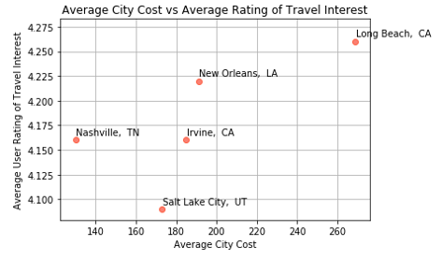
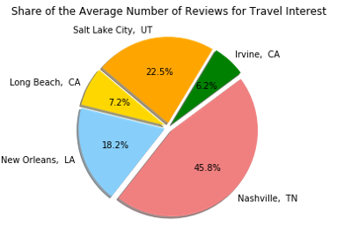
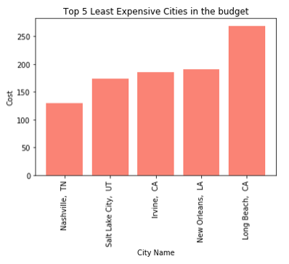
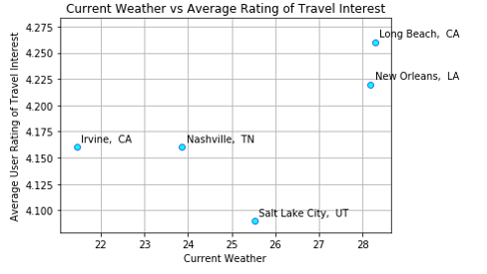
Search Result – Night Life on a Budget
Min trip cost per day: $100
Max trip cost pre day: $300
Travel Interests: ‘Night Club’

Slide 9
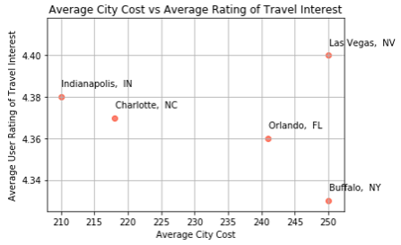
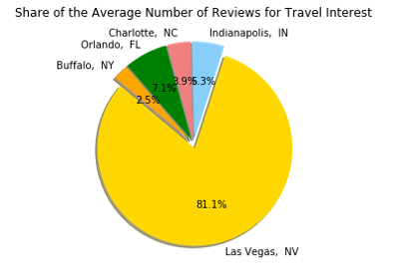
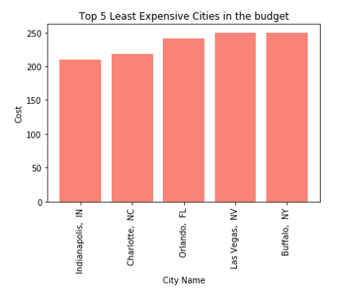
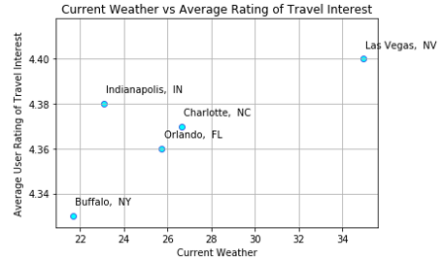
Search Results - Hotels
Min trip cost per day: $200
Max trip cost pre day: $500
Travel Interests: ‘Hotel’

Slide 10

Come visit!

Slide 11

Scope of Improvement & Expansion Potential
Other Data to Increase Search Parameters
Increasing the number of interests that can be sorted on
Expand the code slightly to allow user to select more than one interest
Provide similar information for both interest
Combine interests into an index of some kind
Increase the amount of input from user such as ‘are any children travelling with you?’
Include data that assists with ranking cities for travel by any special needs
Include airline information
Are there any direct flights between airports?
Rank cities based on cheapest routes from starting airport
Adding in geographic features like beaches and natural parks
Other Visualizations
Heat maps of cities showing areas that have a high concentration of ranked restaurants, hotels, bars, etc.
Weather maps

Slide 12
Scope of Improvement & Expansion Potential
Google API
Data needs a thorough reviewed and cleaned
Two types of double counting of establishments
An establishment can be marked as both a restaurant and a bar
Establishments appearing more than once for a single keyword
Ex: A single zoo would be listed multiple times, for example Lincoln Park Zoo was counted several times
Each page returns maximum 20 results, we can increase number of pages to expand sample
API call for a single page and our fixed # of cities returned 20,000+ rows and took 30 mins
Imagine, over time, we can collect data and create a time-series database of reviews and account for seasonal variations in reviews
Open Weather Map API
For $ we could download other data to provide a broad picture of weather
30 day forecast
Historical data is available and would allows for the calculation of average and max temps, humidity, and rain for desired months and capture seasonal variation
Statistical weather data API which allows you to get statistical data by main weather parameters for a specific date or month of the year, or for the entire year.

